Slide 1

Generating In-game 3D Self-Expression using Motion Diffusion Model
Team E: Unreal Neural
박수호 이재훈 제해찬 조용현 차승종
Notes:
Hello my name is Seung jong cha.
I am the presenter of team E, and our teams name is Unreal Neural.
Our teammates are ~~ and our project name is Generating in-game 3d self –expression using motion diffusion model.

Slide 2
Contents
Intro
Background
Related Work
Problem Statement
Proposed Solution
Project Plan
Role Assignment

Slide 3
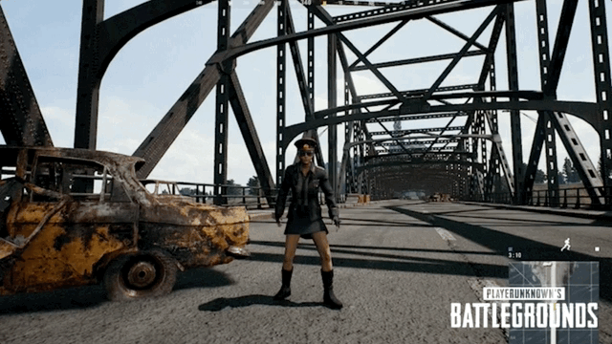
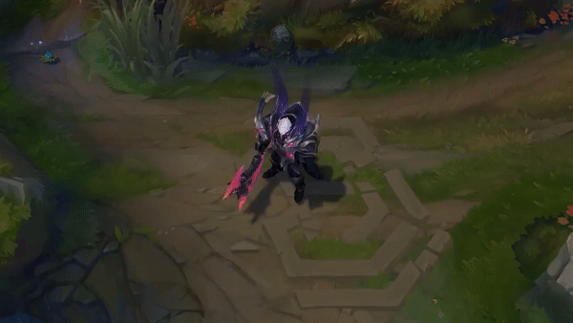
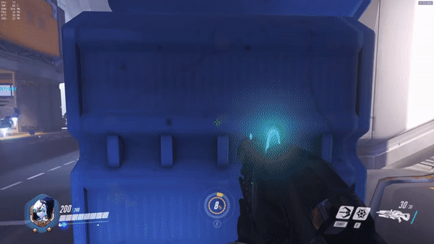
Intro
Emote
Notes:
Let's talk about online-game. In many games, as we can see, there are several self-expression tools with user's character. We just call these tools for "emote".

Slide 4

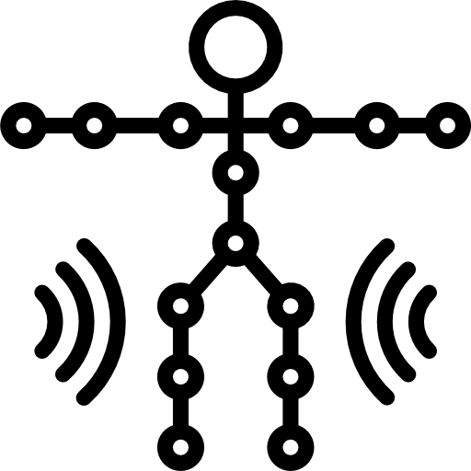
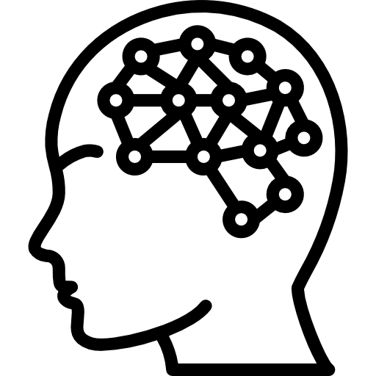
Intro
Emote
Motion Technique
AI
Notes:
So, how are these Emotes made these days??
This "emote" system for 3d character is made by motion technique such as motion capture. Applied with AI which is used for generating 3D models.

Slide 5
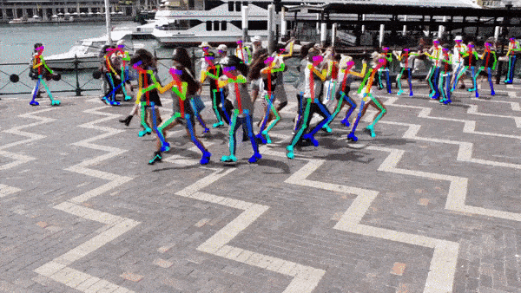
Background: Human-pose estimation
Localize joints and pose from the input video.
Detect meaningful semantic key points through CNN models.
Making skeletons are a key technique for making 3D animation.
Notes:
So, we studied about how the AI make 3D animated model.
The key technique is human-pose estimation.
This pose estimation technique is one of significant task in Computer vision.
It localize human's joint or pose. In last days, we should wear motion capture equipment things.
However, with improvement of deep learning, now we can estimate the pose just on real-time video without wearing bulky equipment.
As we can see in this left video, we just get human's pose as skeleton.
And this skeleton, made by human pose estimation is key technique for make 3D animation.

Slide 6
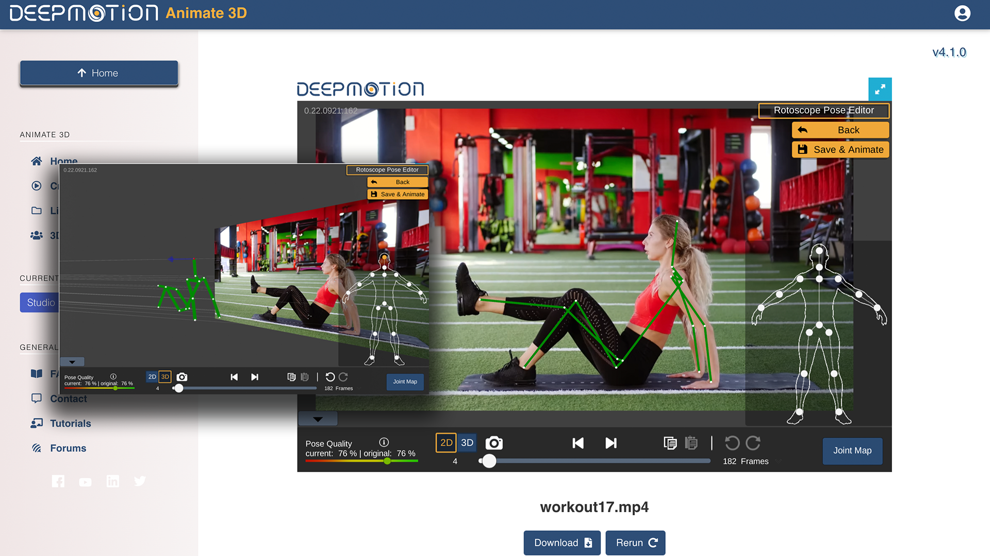
Background: Deep motion
Web Application which converts video to 3D animation.
AI motion capture & body tracking.
Notes:
This, Deep Motion program makes 3D model too.
It is web application that convert video to 3D animation.
AI motion capture

Slide 7
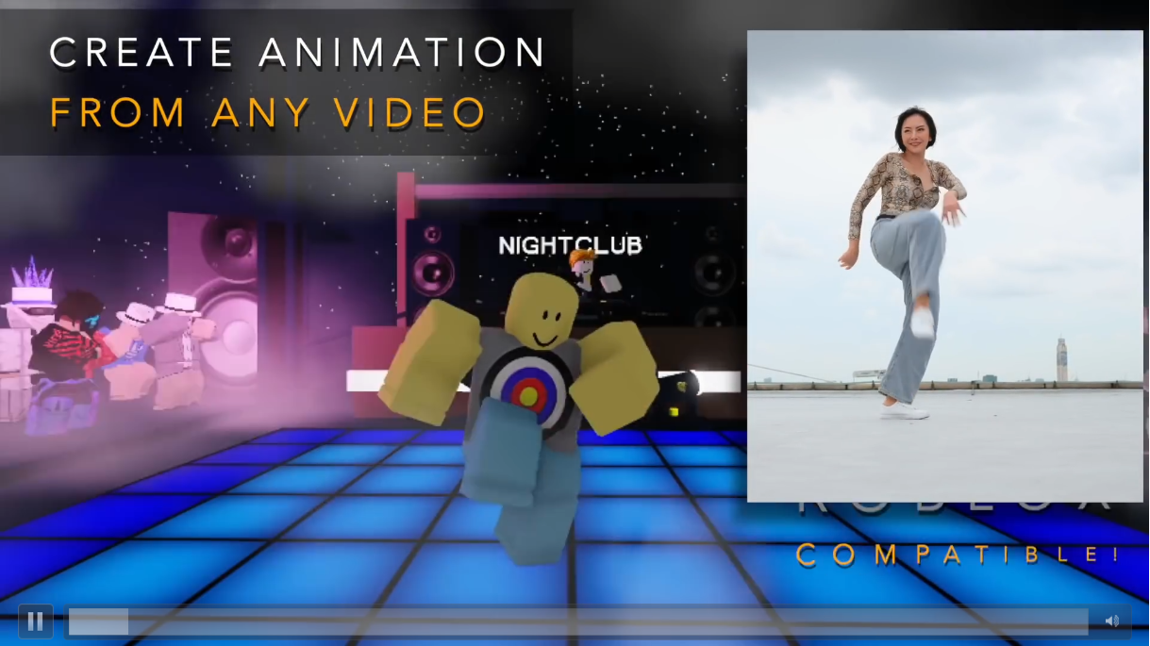
Related Work: Deep motion applied to Roblox
Notes:
Then, how these 3D models is applied to real game engine?
Here is some related work for trying this 3D models to game.
First, the Deep motion.
Roblox is kind of game making tools, and as we can see, they use robot-like character.
Using deep motion tool, like this video, we can apply the video actions to game character.

Slide 8
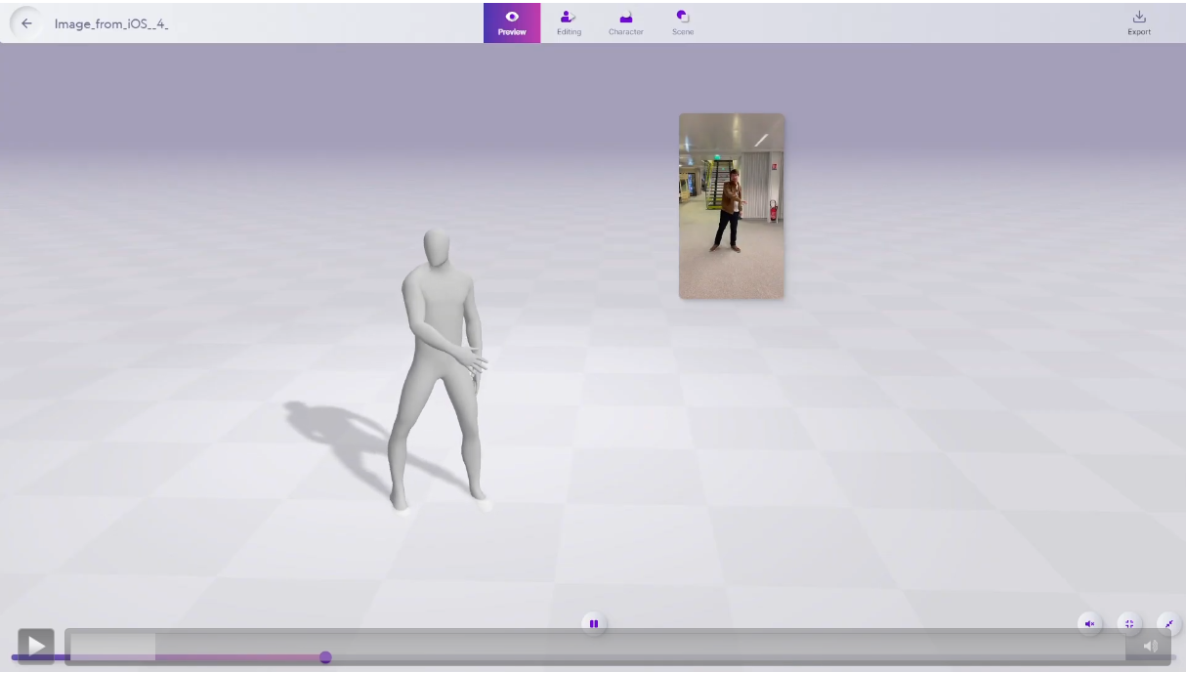
Related Work: Kinetix
Notes:
Other tool is Kinetix.
Like deep motion tool, it can apply created 3D model to Metaverse character.

Slide 9
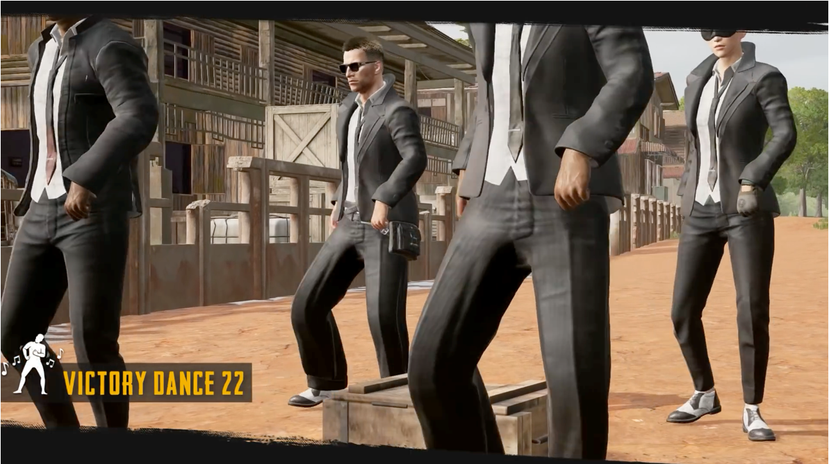
Problem Statement
Human has to act themselves in order to create an animation.
Notes:
However, even many tools exists, in real game company, they don't use AI making tool.
In example, battle ground game, they makes emote with motion capture equipment.
They create model manually.

Slide 10
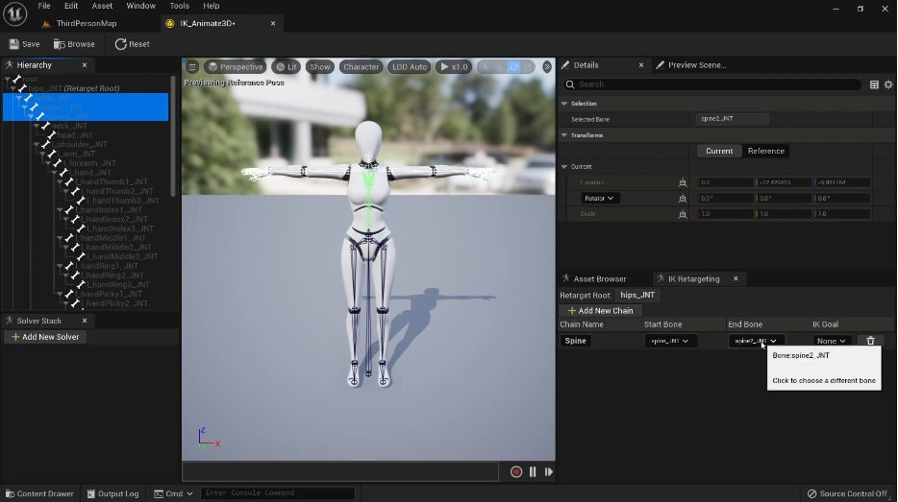
Problem Statement
Mismatch of skeleton framework with 3D animation file and in-game character model.
=> Retargeting 3D animation skeleton framework is inevitable.
Notes:
Also,

Slide 11
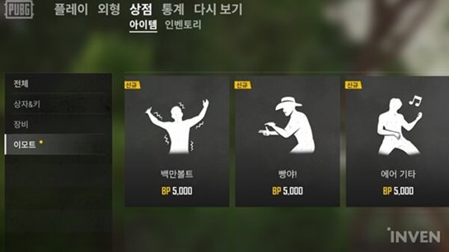
Problem Statement
Can only use predefined 3D animation
- Users cannot create 3D animations themselves.
Notes:
Also, there are some other problems with game emote system.
First, we can only use predefined 3d animation.
It means, we cannot create own emote animation.
Even we introduce deep motion or kinetix, in user's side, it is hard to make animation.

Slide 12
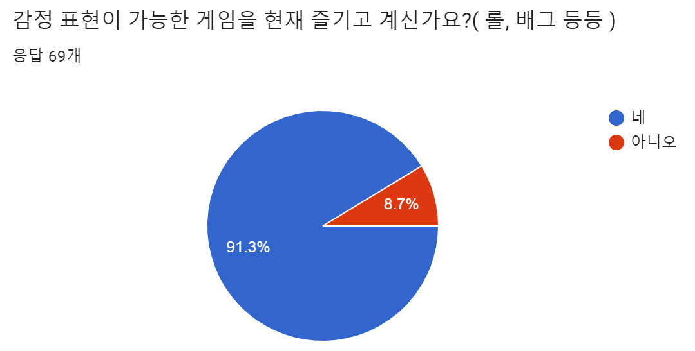
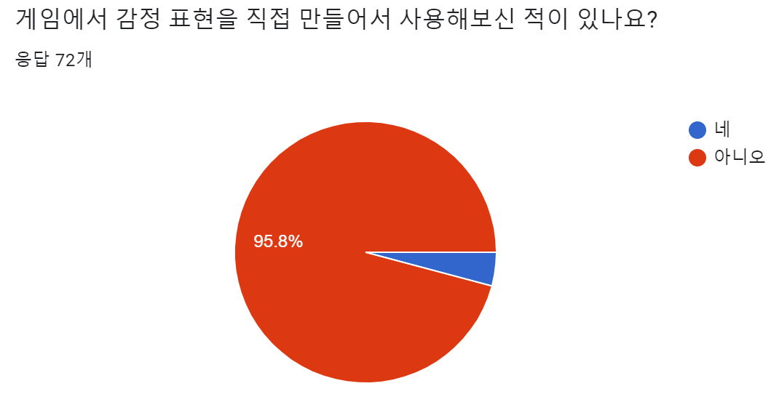
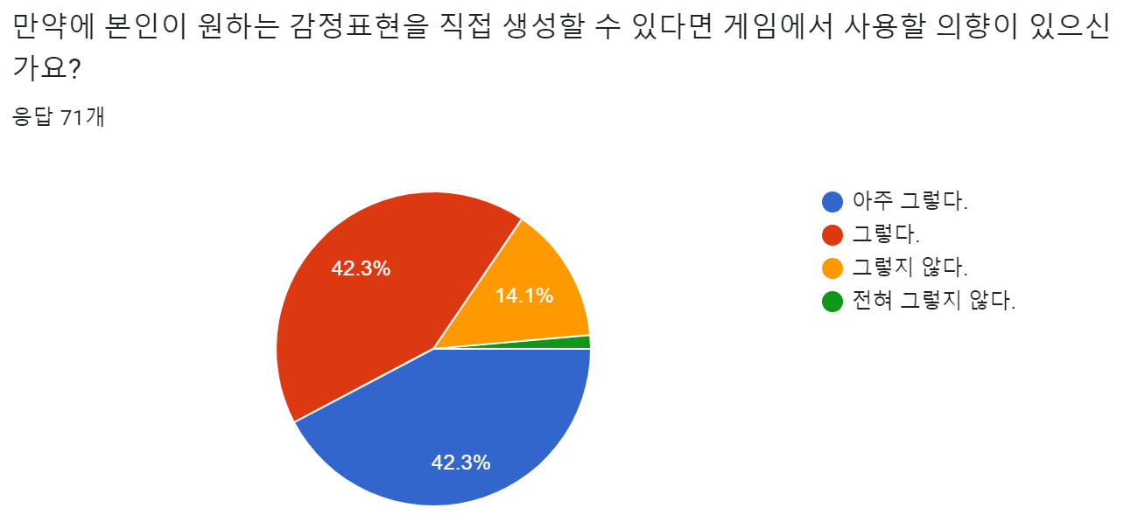
Problem Statement: Survey
Notes:
감정표현이 들어간 게임을 많은 사람들이 하고 있었고 -> 감정표현을 만들어본 적이 없음에도 불구하고 -> 감정표현을 만들 수 있다면 사용하겠다고 대답한 사람들이 대부분이었다. + 따라서 설문조사를 통해 사람들이 게임에서의 모션에 대한 수요가 있다고 결론내릴 수 있다.

Slide 13
Proposed Solution
Is there a way to create an animation without humans acting themselves?
Is there a way for game users to customize animation personally?
Is there a way to remove the process of ‘Skeleton retargeting’?
Notes:
We want to make animation easily in real-game play time.
Then, we inspired from 'kakaotalk Emotions with typing command'. Why only motion?

Slide 14
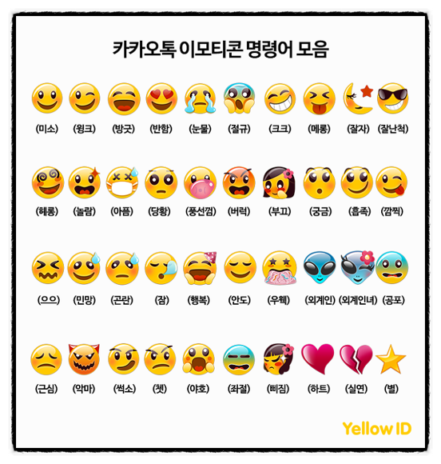
Proposed Solution
How about using text as an input?
Inspired from 'KaKaoTalk Emotions with typing command'
Notes:
We want to make animation easily in real-game play time.
Then, we inspired from 'kakaotalk Emotions with typing command'. Why only motion?

Slide 15
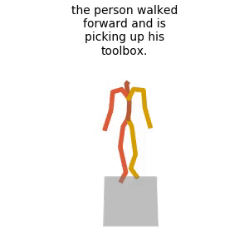
Proposed Solution: Motion Diffusion Model
Motion Diffusion Model for ‘Text to Motion’
Model of generating a motion given an input text prompt.
Apply Motion Diffusion Model to an in-game chat to create 3D animation for in-game characters.
Deploying in a form of Unreal Engine plugin

Slide 16
Motion Diffusion Model: Advantages
Accessibility No need for humans to act themselves to make a 3D animation.
User - friendly Users can customize their own 3D animations through in-game chat.
Efficiency
Step of retargeting bones for 3D animations can be removed through implementation of plugin.

Slide 17
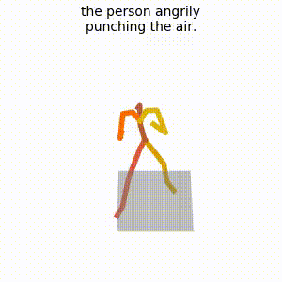
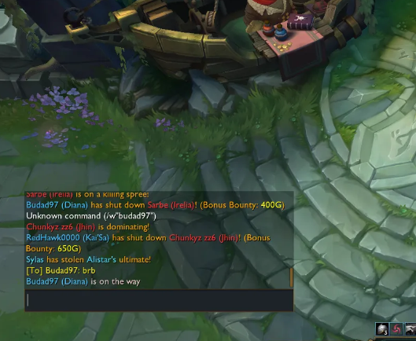
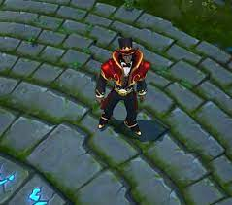
Overview of Final Product (User Scenario)
Enter: Punching angrily

Slide 18
Project Plan
 | Week 3 | Week 4 | Week 5 | Week 6 | Week 7 | Week 8 | Week 9 | Week 10 | Week 11
Retargetting Animation (Skeleton)
Model performance and speed improvement
Adjustment model to Unreal Engine
Implement plug-in function library
Implement simple demo
Packaging and deploy

Slide 19
Role Assignment
CV/AI 박수호, 차승종: Motion diffusion model performance improvement, Data collection, Model training.
Unreal Engine
이재훈: Adjustment of model to Unreal Engine.
제해찬: Plugin function library implementation.
조용현: Building demo project and animation postprocessing

